Slide 1
Contents
DigiPen Resources
Copyright Free Resources
Recommended Tools
References
Banned

Slide 2
Copyright
To keep things simple to understand, assets used in projects such as, and not limited to, audio, fonts and images, have to be created by current students of DigiPen
Any assets downloaded from the internet, even if the student paid for it legally, cannot be used in projects
The only exceptions are resources that DigiPen paid for, or resources that lecturers verified and approved
Remember: just because it’s “Free to Download”, doesn’t mean it’s “free to use”
Remember: just because someone on the internet uploads the files and says it’s free to use, doesn’t mean it is so; that person may not be the original creator and does not have the right to approve its use
When in doubt, please ask a lecturer, or don’t use it
Resources:
https://libguides.singaporetech.edu.sg/copyright
https://www.ipos.gov.sg/docs/default-source/resources-library/copyright/copyright-act-factsheet.pdf
https://singaporelegaladvice.com/law-articles/copyright-law-in-singapore/
https://www.gamedeveloper.com/business/myths-and-facts-in-avoiding-copyright-infringement

Slide 3
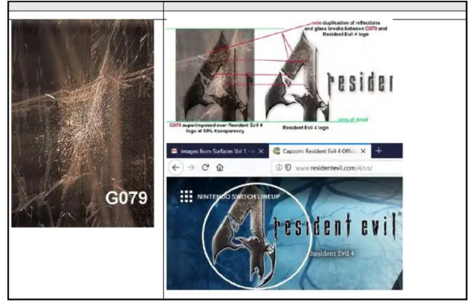
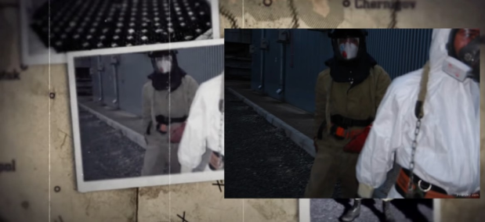
Lawsuits and Infringements
Resident Evil 4 , Devil May Cry - photos from book were used in game textures
https://www.polygon.com/22519568/resident-evil-4-copyright-infringement-lawsuit-capcom
Call of Duty: Modern Warfare - copyrighted photograph used in game cutscene
https://www.youtube.com/watch?v=wVYOByvauuY

Slide 4
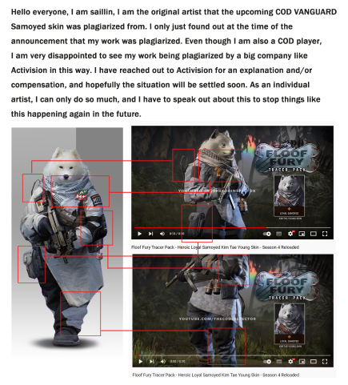
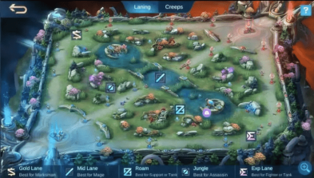
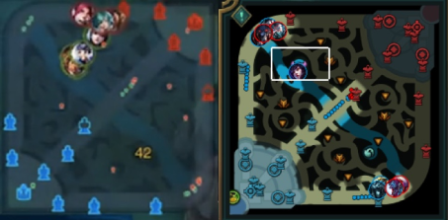
Lawsuits and Infringements
Call of Duty : Warzone - Character skin plagiarised from character concept artist’s works
https://kotaku.com/call-of-duty-activision-sail-lin-loyal-samoyed-stolen-1849396914
League of Legends vs King of Glory vs Mobile Legends
https://www.polygon.com/23064347/riot-games-league-of-legends-knockoffs-mobile-legends-bang-bang

Slide 5
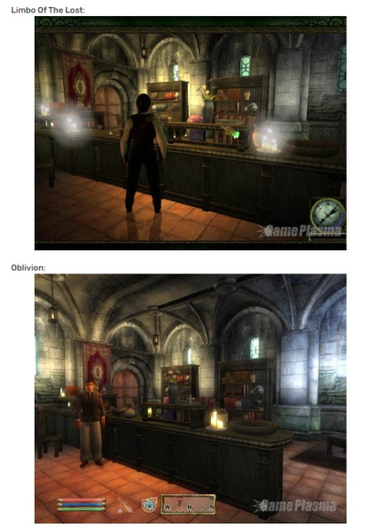
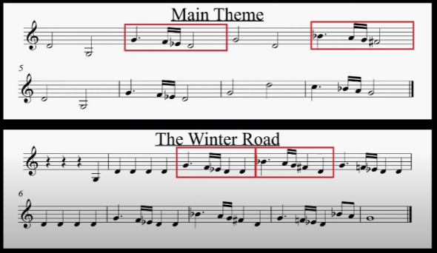
Lawsuits and Infringements
Limbo of the Lost - stolen art assets used in game
https://www.rockpapershotgun.com/limbo-of-the-lost-an-astonishing-tale
https://www.gamesindustry.biz/limbo-of-the-lost-axed-amid-plagiarism-row
Metal Gear Solid - Theme song accused of plagiarism
https://www.shacknews.com/article/56354/metal-gear-solid-theme-removed
https://www.youtube.com/watch?v=7ZLOF9IaEig

Slide 6
DigiPen Resources
The following resources are available on the DigiPen Share servers and are usable in all your projects.

Slide 7
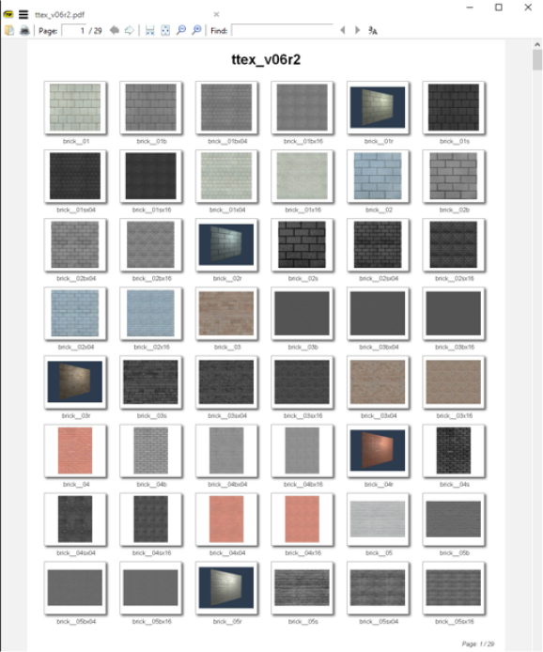
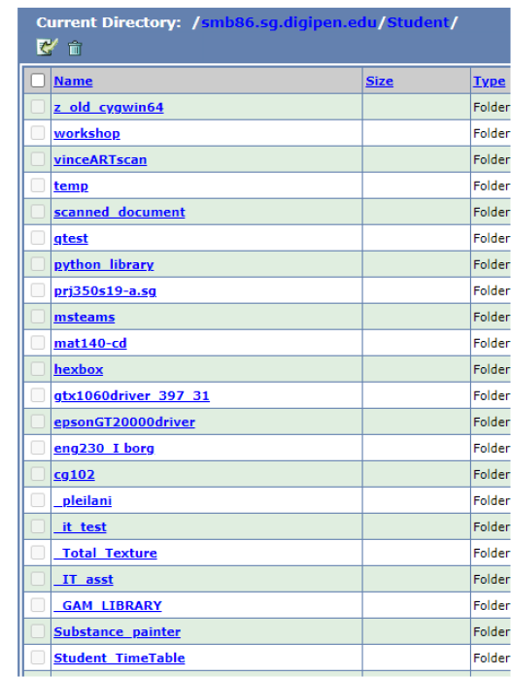
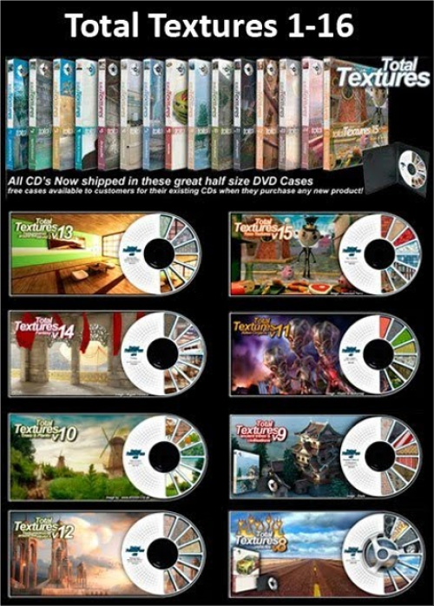
DigiPen Resources
Total Textures
Licensed photo textures
Available on Student S: Drive
S:\_Total_Texture\
Download Contact Sheets pdf to scan through library before downloading the original images

Slide 8
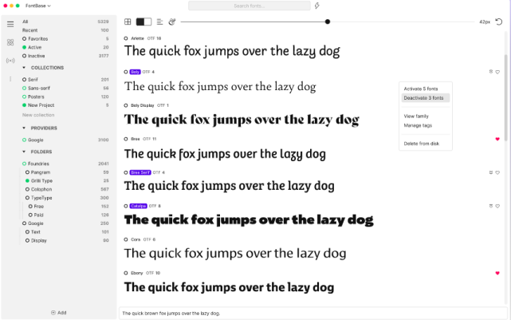
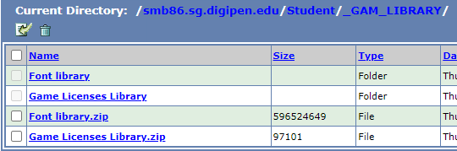
DigiPen Resources
Approved Fonts
Approved Font library
Available on Student S: Drive
S:\_GAM_Library\Font_Library.ZIP
Download ZIP file and use FontBase to preview fonts: https://fontba.se/

Slide 9
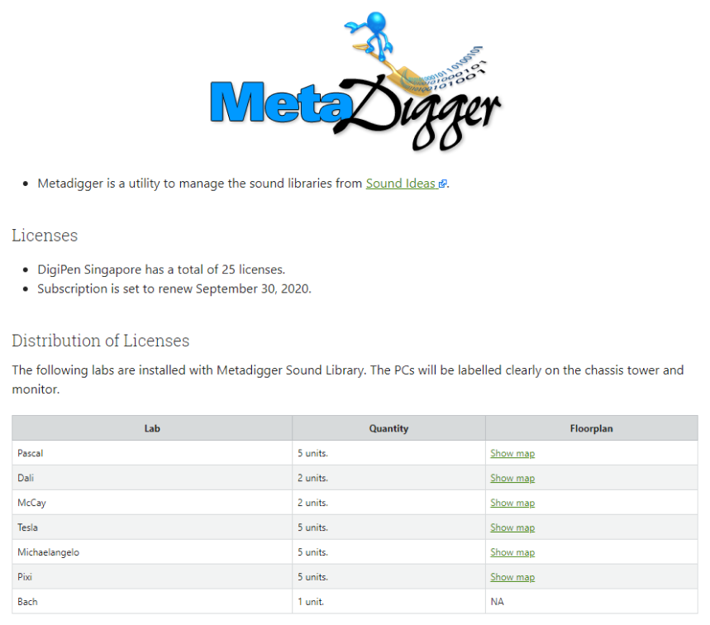
DigiPen Resources
Meta Digger
Licensed sound library from Sound Ideas Available in Pascal, Dali, McCay, Tesla, Michaelangelo, Pixi #SFX #MusicTracks
To find the PC-Labs maps of the installed software, go to:
http://it-faq.sg.digipen.edu/Softwares/index.html
and check the “Music” link.

Slide 10
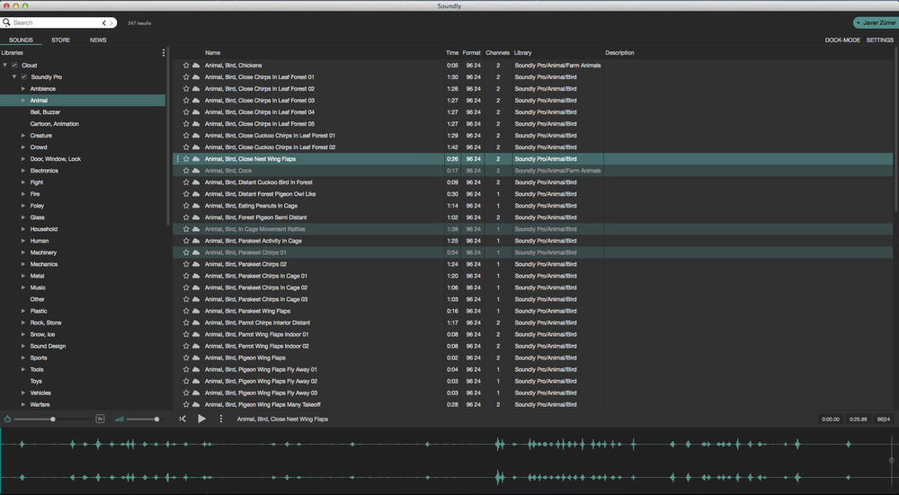
DigiPen Resources
Soundly
Licensed sound library from Soundly Available in DigiPen Library, speak to Librarian Mira #SFX

Slide 11
DigiPen Resources
Current DigiPen Students
Assets created by current DigiPen students may be used in your projects, please credit them
Assets created by graduated or soon-to-be DigiPen students may not be used

Slide 12
Copyright Free Resources
The following resources are copyright free under the Creative Commons CC0 1.0 Universal License, and are usable in all your projects.

Slide 13
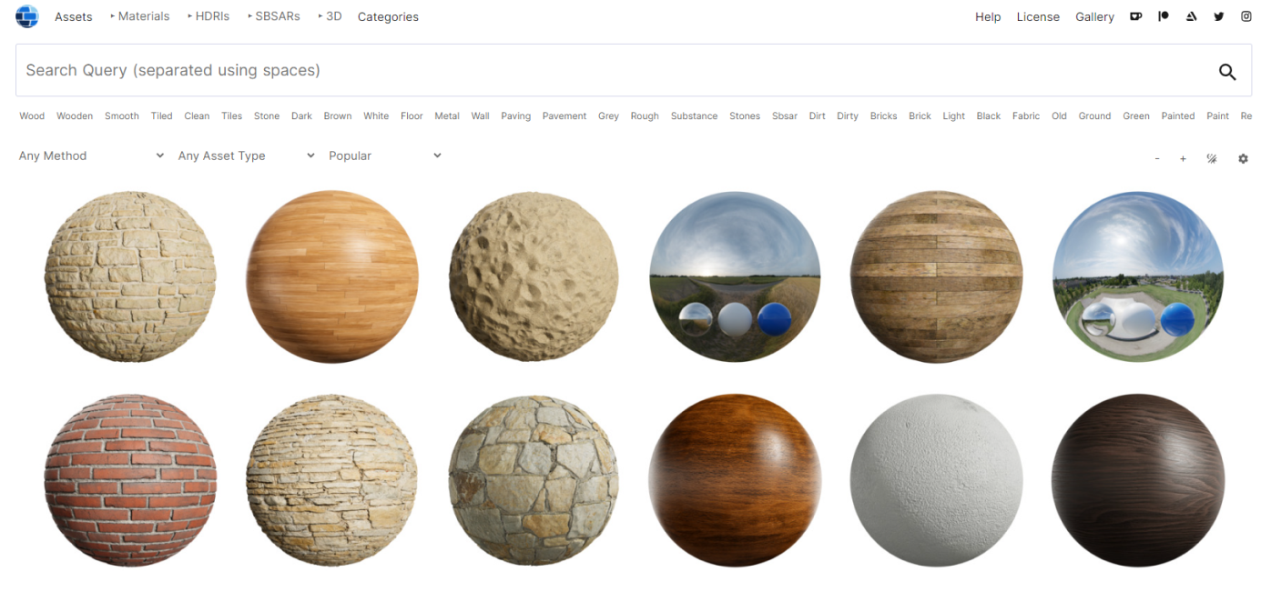
Copyright Free Resources
Ambient CG
License details: https://docs.ambientcg.com/books/website-licensing/page/license-information
Link: https://ambientcg.com/
#Textures #HDRI #SubstanceDesigner

Slide 14
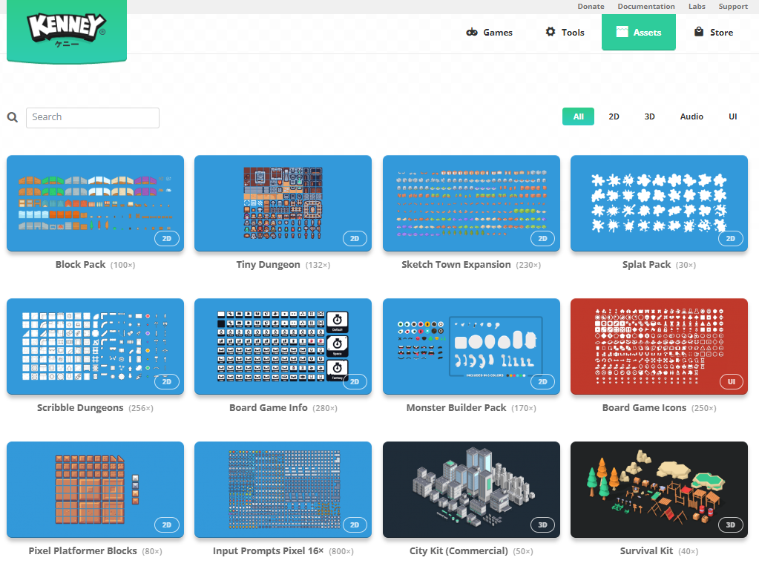
Copyright Free Resources
Kenney Assets
License details: https://kenney.nl/support, https://creativecommons.org/publicdomain/zero/1.0/
Link: https://www.kenney.nl/assets
#3dModels #Textures #RiggedCharacters #UserInterface

Slide 15
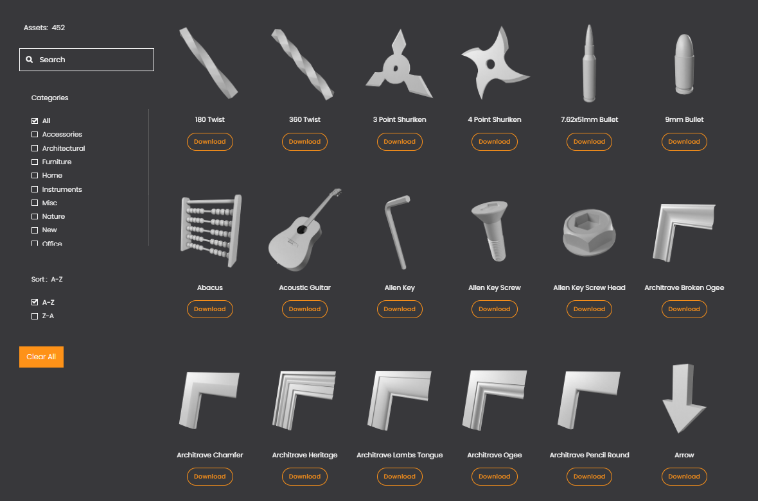
Copyright Free Resources
The Base Mesh
License details: https://thebasemesh.com/faqs, https://creativecommons.org/publicdomain/zero/1.0/
Link: https://thebasemesh.com/
#3dModels

Slide 16
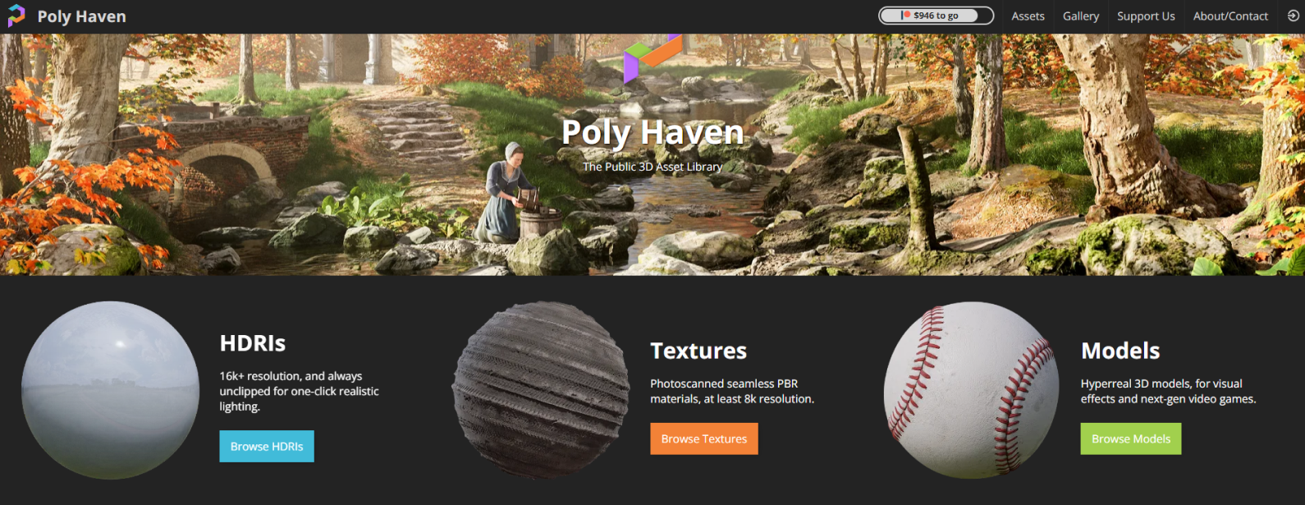
Copyright Free Resources
Poly Haven
License details: https://polyhaven.com/license
Link: https://polyhaven.com/
#3dModels #Textures #HDRI

Slide 17
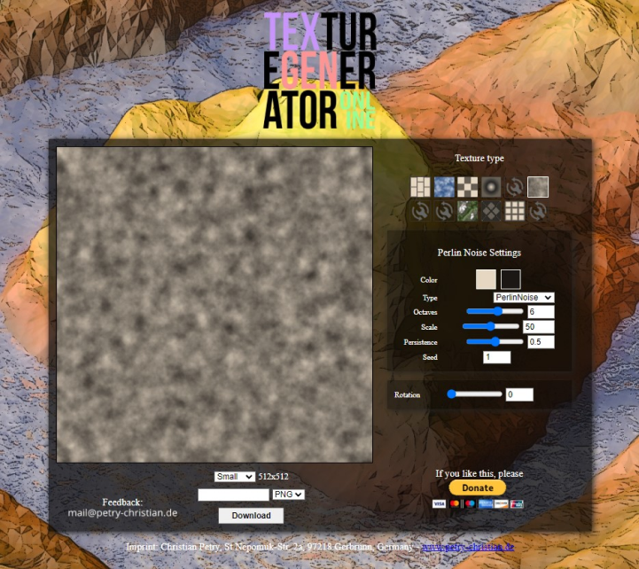
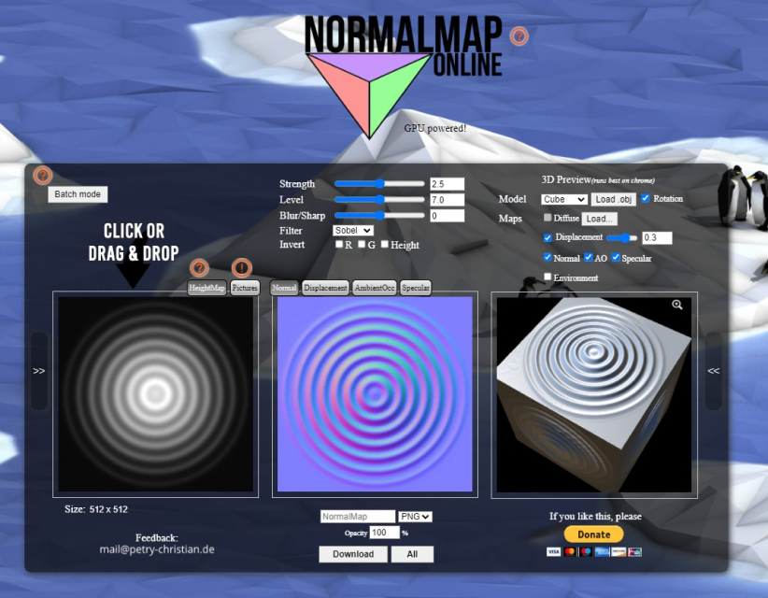
Copyright Free Resources
Texture Generator + Normal Map Generator
License details: https://github.com/cpetry/NormalMap-Online
Link: https://cpetry.github.io/NormalMap-Online/
Link: https://cpetry.github.io/TextureGenerator-Online/
#Textures #NormalMap

Slide 18
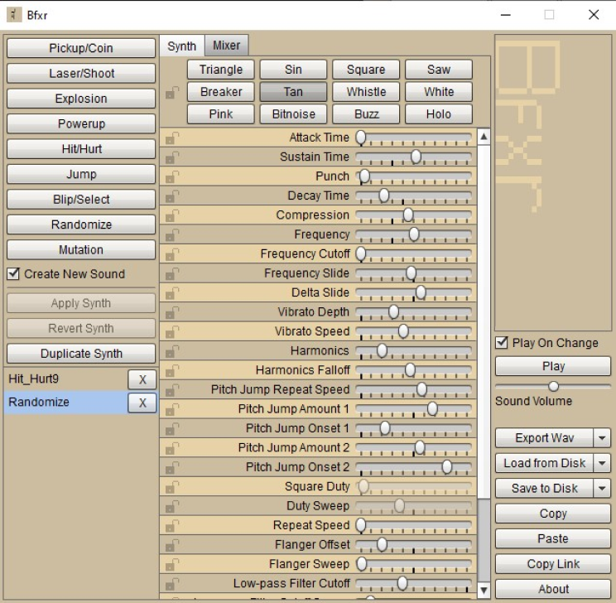
Copyright Free Resources
BFXR
License details: https://www.apache.org/licenses/LICENSE-2.0.html
Link: https://www.bfxr.net/
#SoundFX

Slide 19
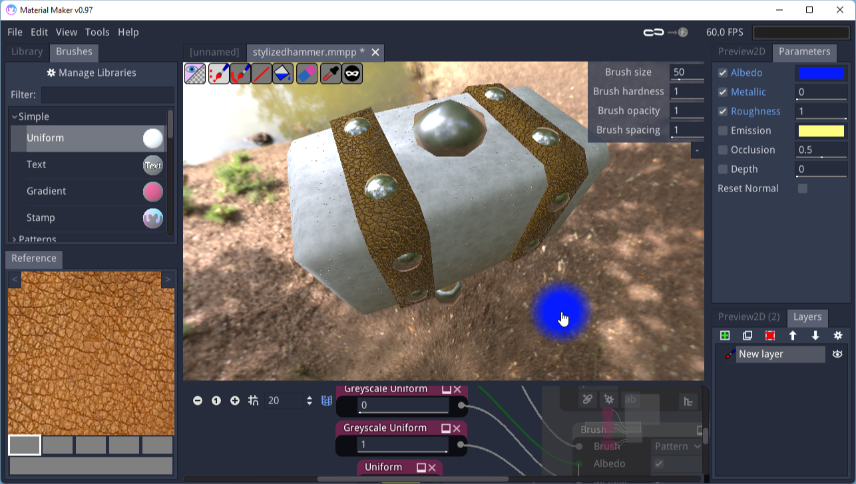
Copyright Free Resources
Material Maker
License details: https://creativecommons.org/share-your-work/public-domain/cc0/
Link: https://www.materialmaker.org/
Link: https://www.materialmaker.org/materials?count=10&type=material&license_mask=2
#Textures

Slide 20
Recommended Tools
The following tools are highly recommended for your development use.

Slide 21
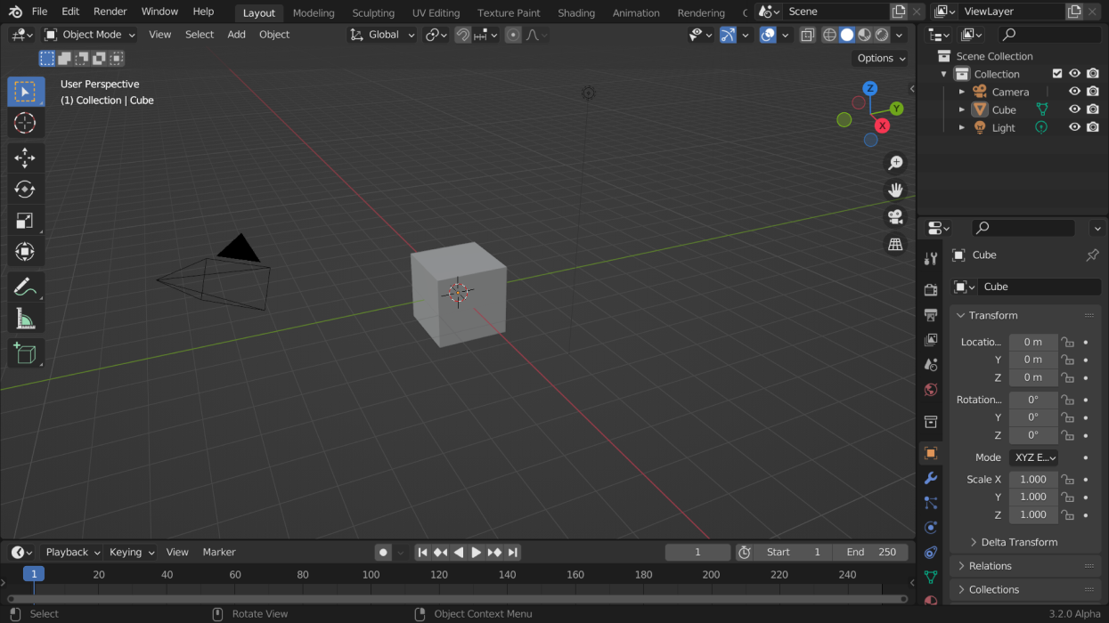
Blender
Free
3d modeling DCC
Link: https://www.blender.org/
Recommended learning resource - Arrimus 3D: https://youtu.be/p56nY74bSzs

Slide 22
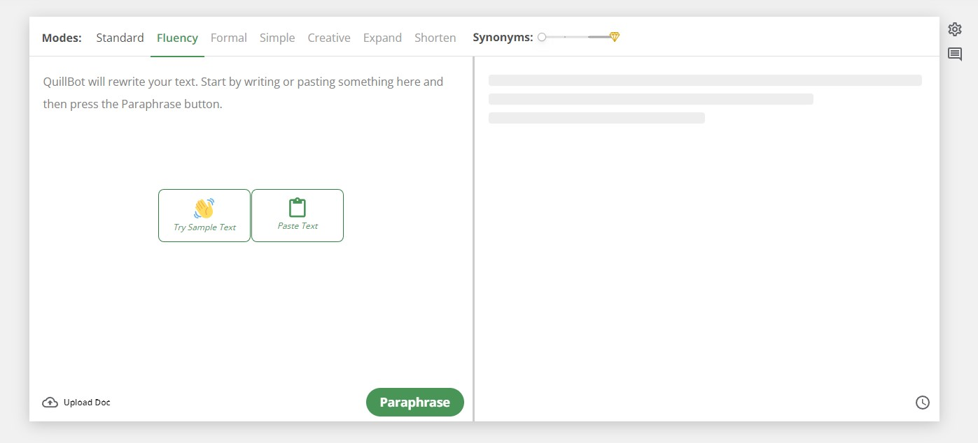
QuillBot
Free
Grammar checker, Paraphrasing tool
Link: https://quillbot.com/

Slide 23
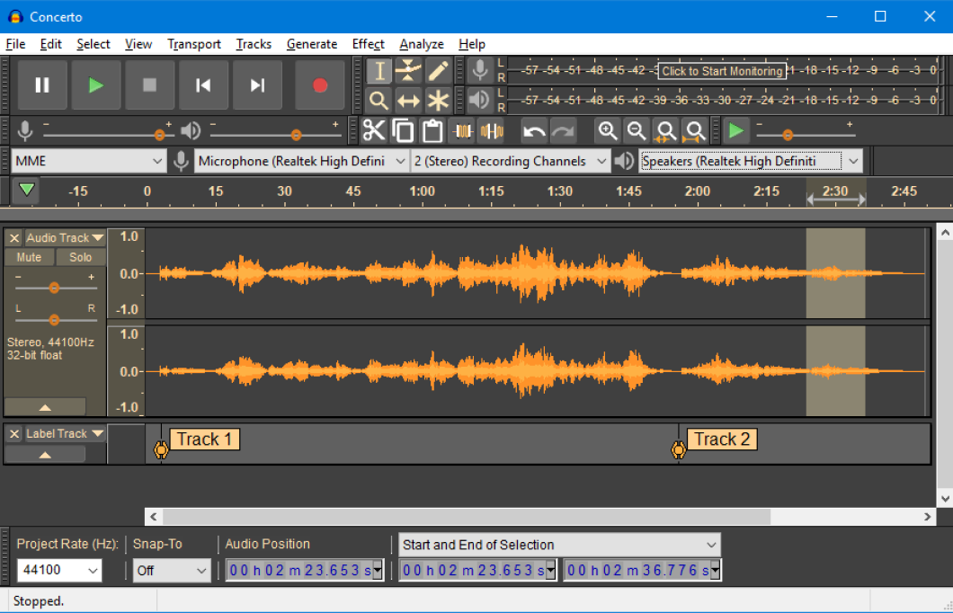
Audacity
Free
Audio editing
Link: https://www.audacityteam.org/

Slide 24
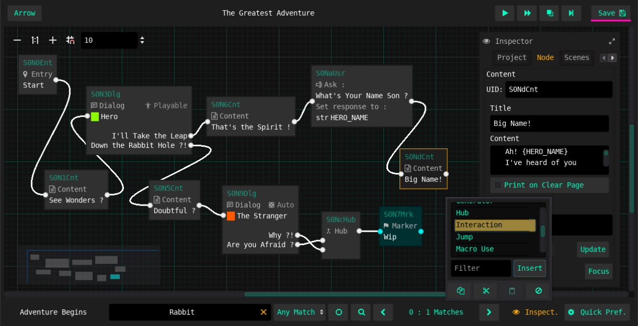
Arrow
Free
Narrative Design Tool
Link: https://github.com/mhgolkar/Arrow

Slide 25
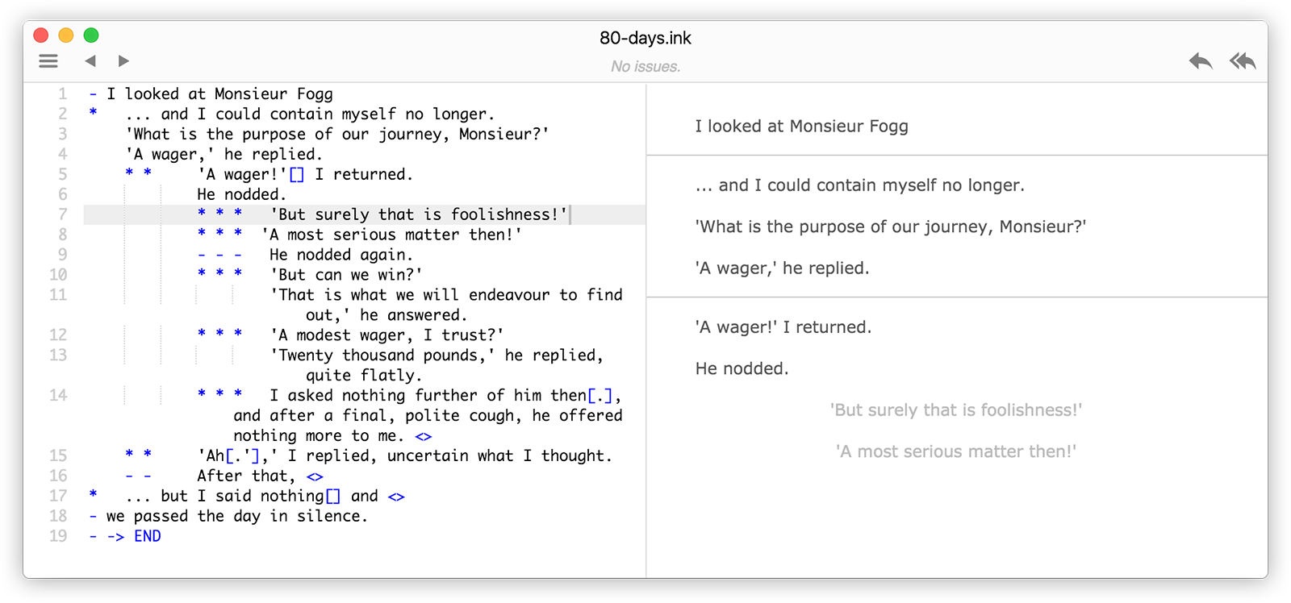
INK
Free
Narrative Design Tool
Link: https://www.inklestudios.com/ink/

Slide 26
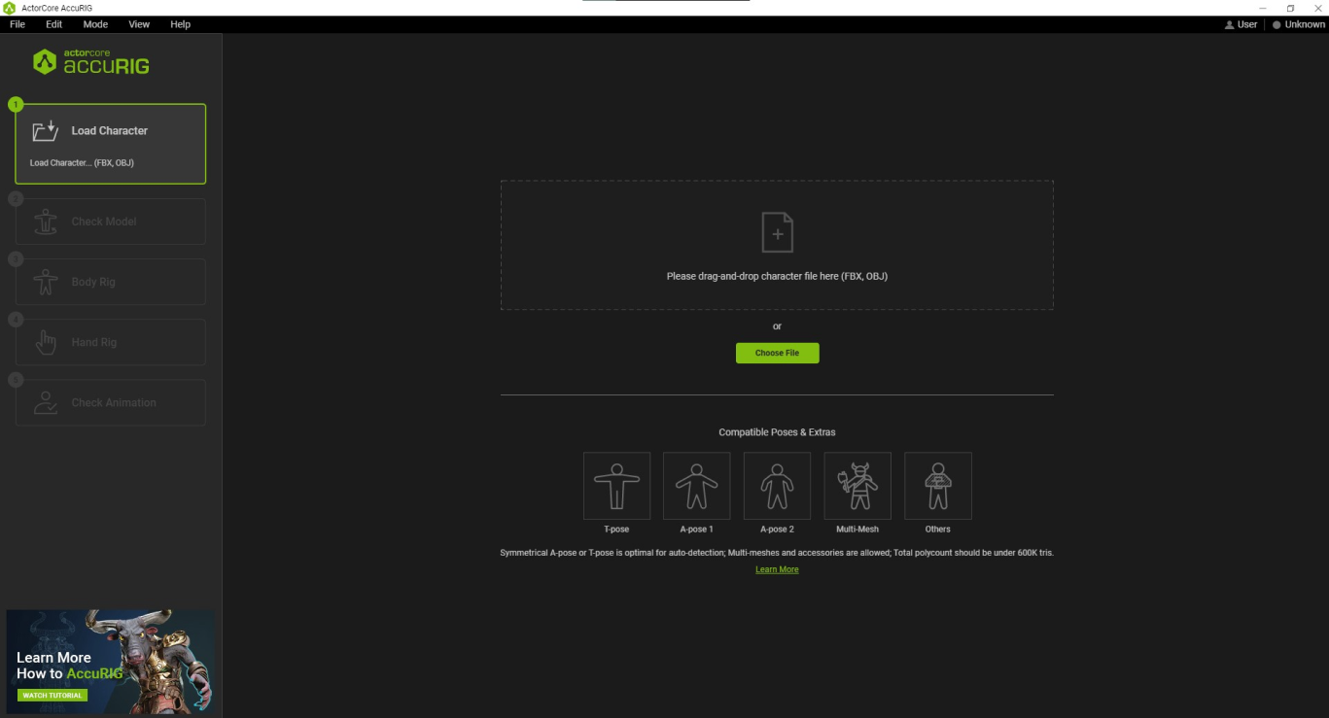
ACCURIG
Free
Character auto-rigging tool
Link: https://actorcore.reallusion.com/auto-rig

Slide 27
References
The following resources will be useful for analysis and game pitches.

Slide 28
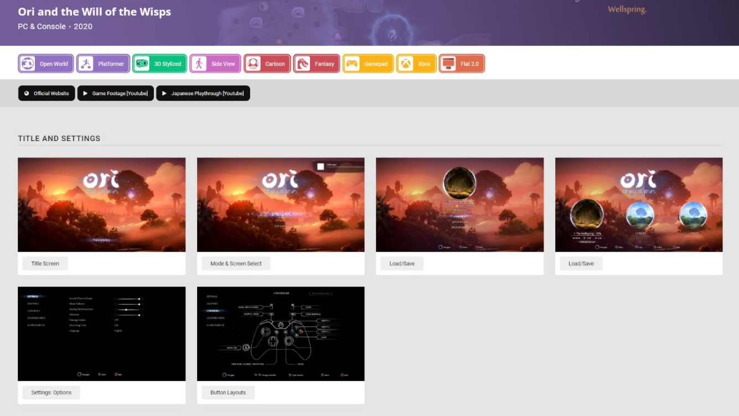
Game UI Database
Link: https://www.gameuidatabase.com/

Slide 29
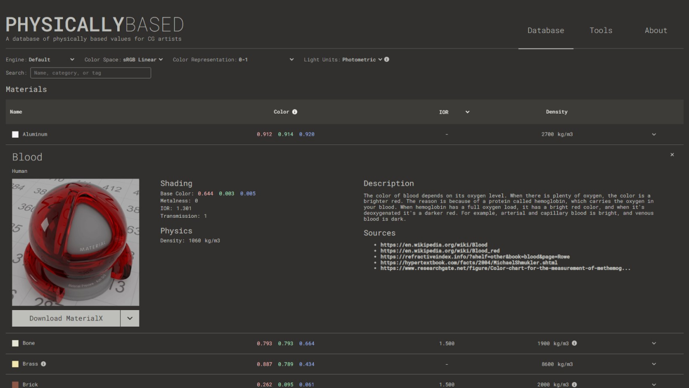
Physically Based
Link: https://physicallybased.info/

Slide 30
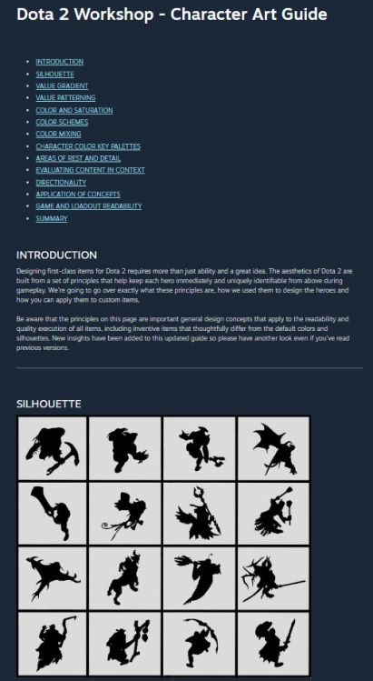
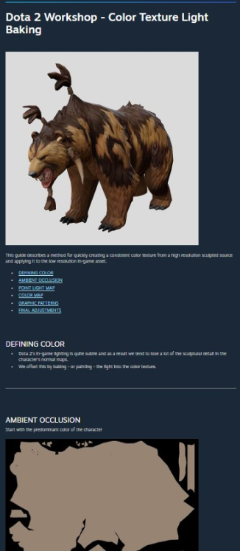
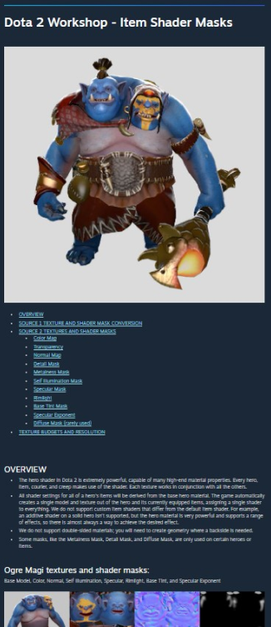
DOTA Art Style Guide
Character Art Link: https://help.steampowered.com/en/faqs/view/0688-7692-4D5A-1935
Colour Texture Light Baking Link: https://help.steampowered.com/en/faqs/view/60E5-5E13-712C-5315
Item Shader Link: https://help.steampowered.com/en/faqs/view/299C-D7F9-09A5-98B6

Slide 31
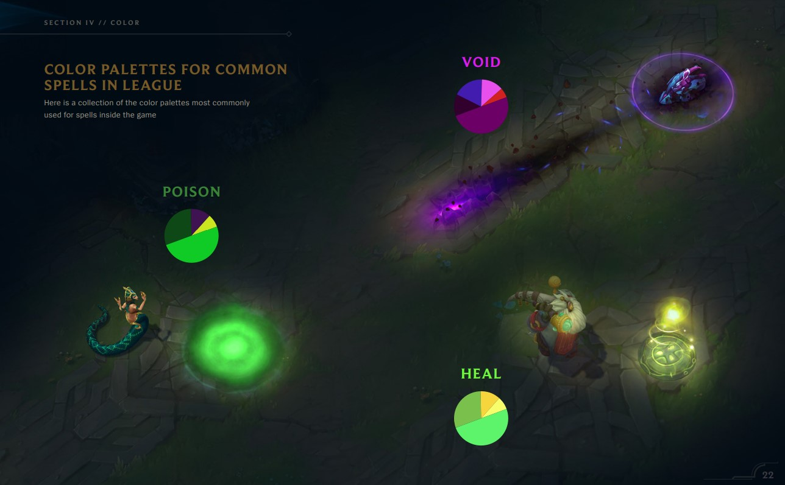
League of Legends VFX Guide
Link: https://nexus.leagueoflegends.com/en-us/2017/10/dev-leagues-vfx-style-guide/
PDF Link: https://nexus.leagueoflegends.com/wp-content/uploads/2017/10/VFX_Styleguide_final_public_hidpjqwx7lqyx0pjj3ss.pdf

Slide 32
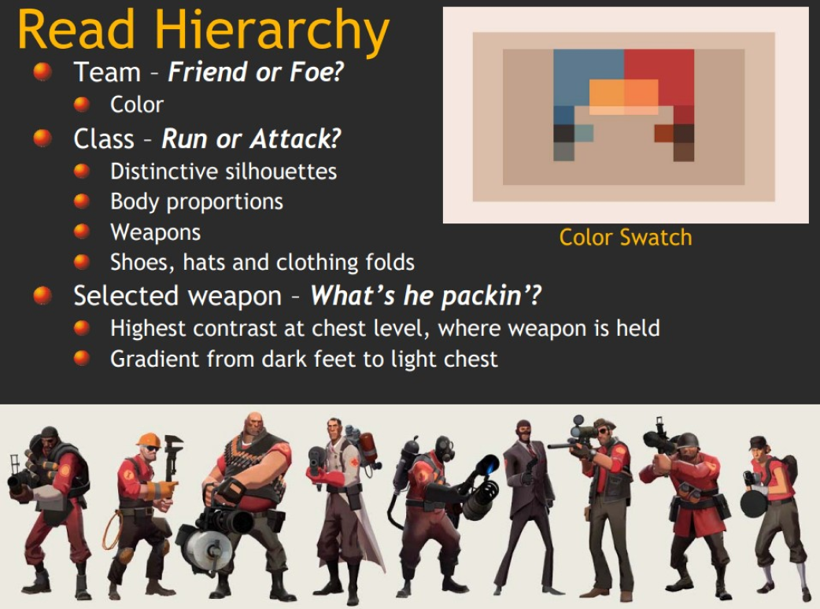
Team Fortress 2 - Connecting Art to Gameplay
PDF Link: https://cdn.cloudflare.steamstatic.com/apps/valve/2008/GameFest08_ArtInSource.pdf

Slide 33
Banned
The following resources are banned for use in Project modules, eg. CSD3400/USG3400

Slide 34
Do not use in your projects
Online Marketplaces - BANNED
Unity
Unreal

Slide 35
Do not use in your projects
Community Sharing Sites - BANNED
Sketchfab
Deviant Art
Pexel
Freesound.org

